Slide 1
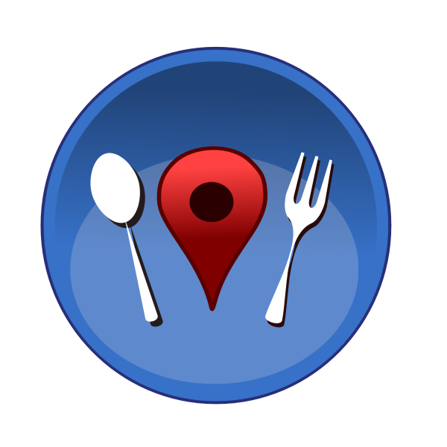
Yelp reviews of restaurants in Arizona
Kevin, Steven, Alex, Kimberly, Andalib

Slide 2
Project 3
We created a dashboard for the best food in Arizona. Here are some of the questions that the dashboard answers:
What type of restaurants do residents of Arizona like?
What are the best restaurants?
Where are the best restaurants?

Slide 3
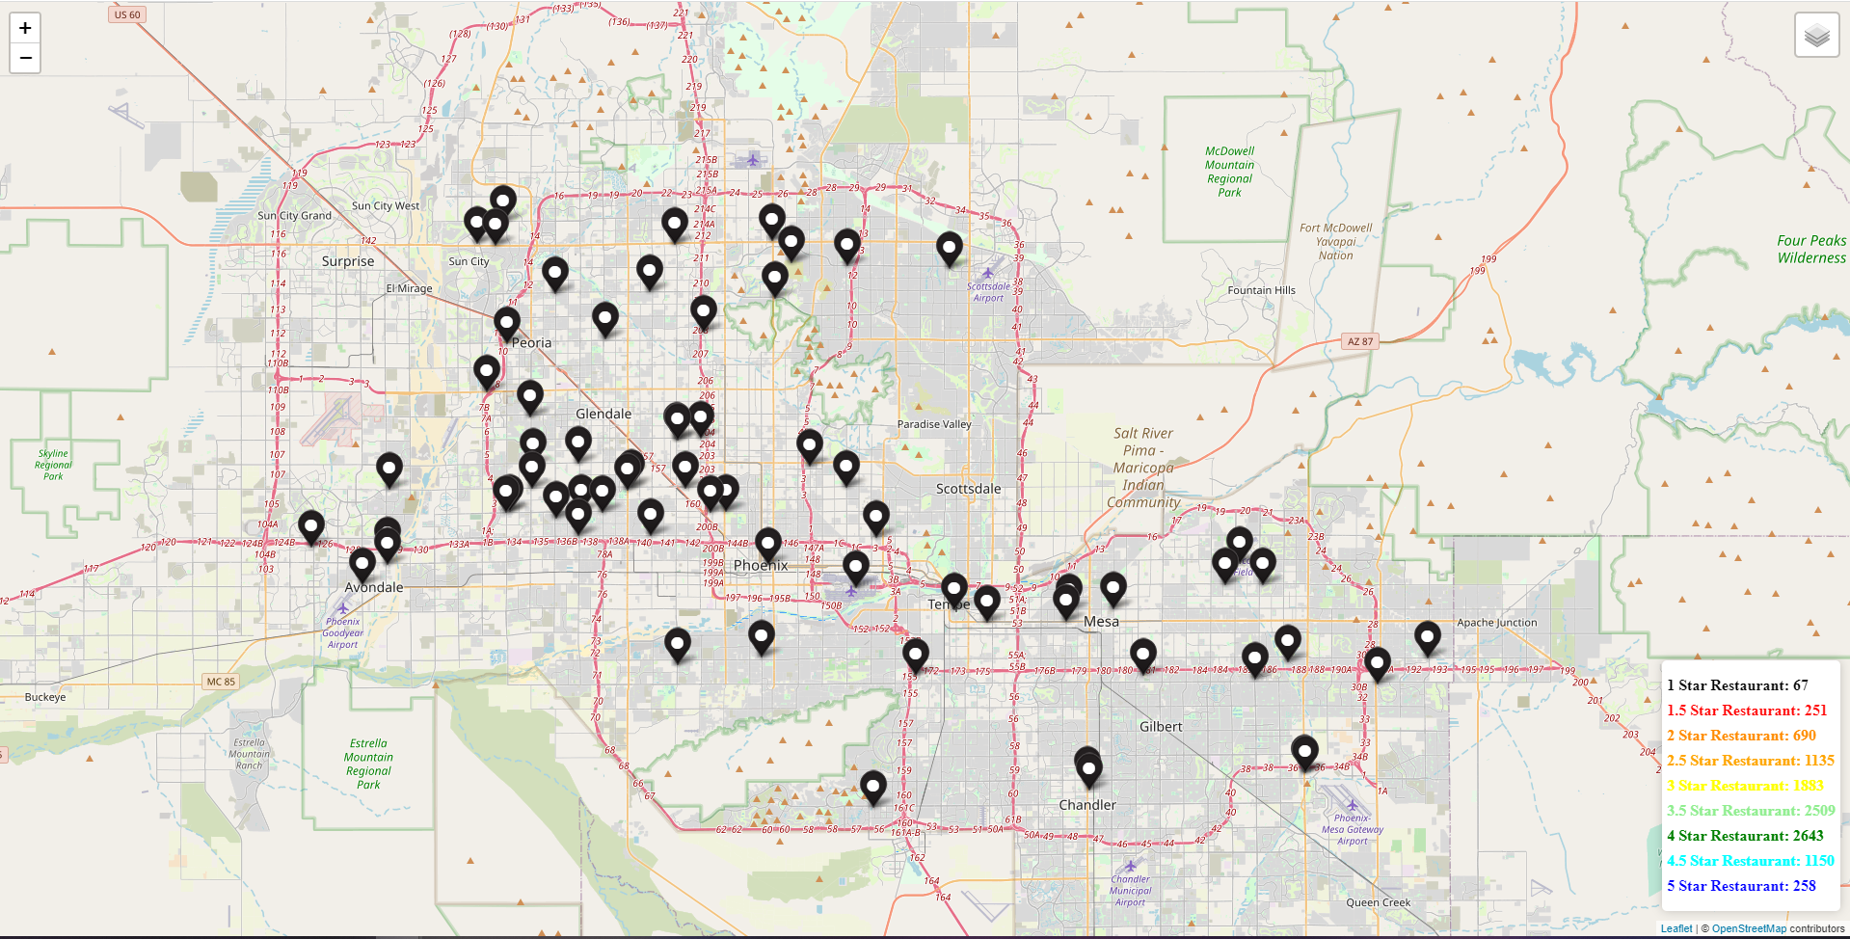
Map Visualization
Map with Leaflet
Map based on star ratings.
The visual shows markers of One-Star Rated Restaurants.
Created many layer groups and had overlays connected to each one.
Used d3.json to take the data.
Ran a loop reading the star ratings.
The ratings would be recorded into a count.
.bindPopup to the L.markers that are recorded.

Slide 4
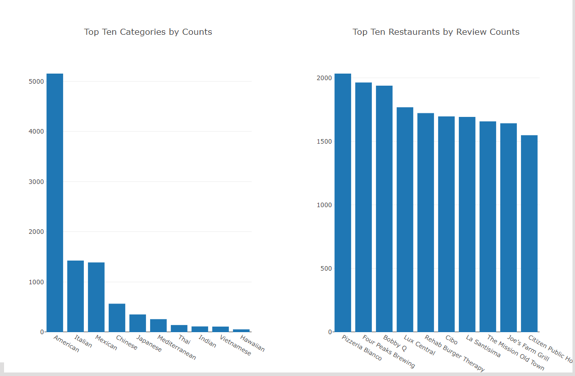
Top Ten Categories by Counts
To get an idea about which categories of restaurants are more popular among Arizonaians, we used a bar diagram which shows the total counts of restaurants by types.
Without any surprise, “American” restaurants came top with “Italians” as the distant second.
As shown in the diagram, the total number of American restaurants is 5154 and the total number of Italian restaurants is 1427.

Slide 5
Top Ten Restaurants by Review Counts
We also used a bar chart to show the top ten restaurants with respect to the number of yelp reviews.
We expect that the higher the number of yelp reviews, the busier the restaurant is.
As shown in the bar chart, ‘Pizzeria Bianco’ (an Italian restaurant) came first with 2035 reviews.
Two American restaurants, ‘Four peaks Brewing’ and ‘Bobby Q’ came second and third with 1965 and 1940 reviews respectively.

Slide 6
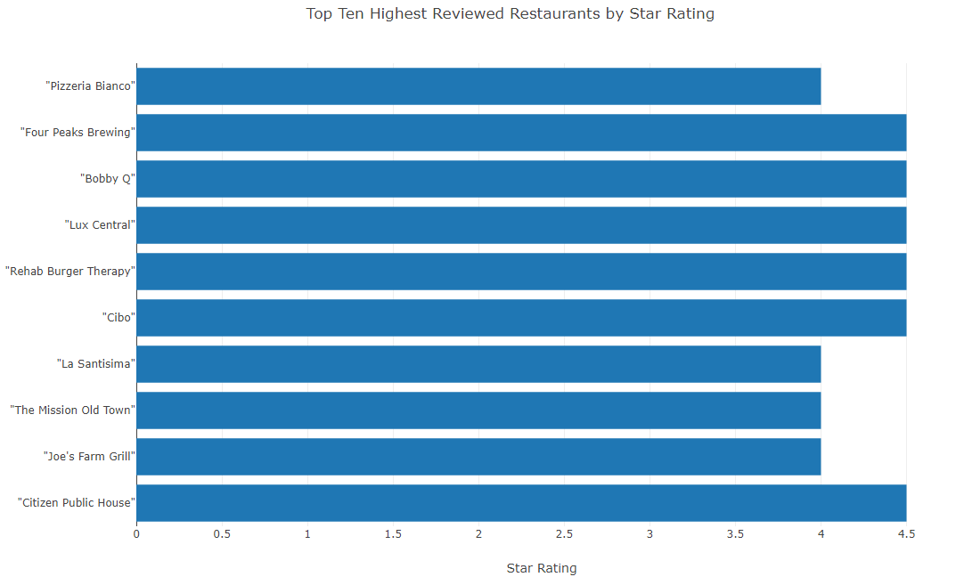
Top Ten Most Reviewed Restaurants by Star Rating
Mixture of food categories at the top
Star ratings are 4 or above

Slide 7
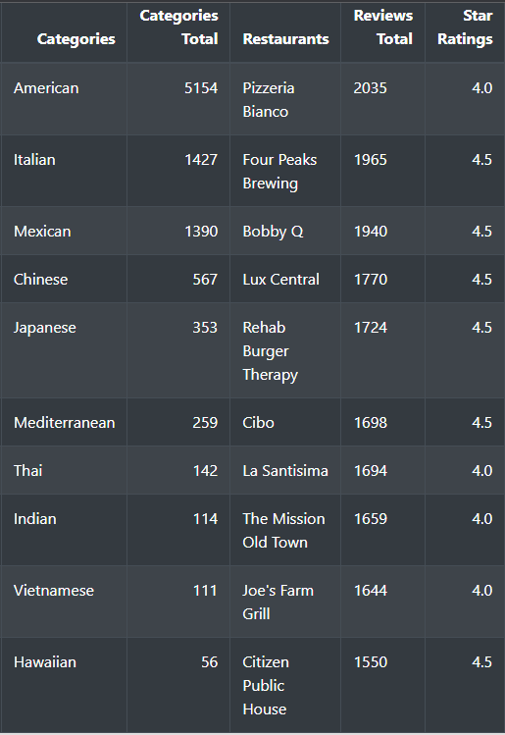
Top Restaurants Summary
Table

Slide 8
Conclusion
Most Restaurants are in Phoenix and Scottsdale across all ratings
Highest food category is American
Mixture of food categories with the most reviewed restaurants
Restaurants with the most reviews have a star rating of 4 or more

